Slide 1
Physical/ Work Capacity Testing
Scott Elms, PT; Janet Kadlecik, OTR

Slide 2
Physical Capacity Testing
An PCE is defined as "an intensive, short-term evaluation that focuses on major physical tolerance abilities related to musculoskeletal strength, endurance, speed and flexibility." (Roy Matheson)

Slide 3
Referral process
Send an e-mail to workcapacities@bendbroadband.com (Scott Elms, MPT)
requesting a date for an evaluation- be specific about location
and type of evaluation (WCE, PCE II, PCE I).
Once a date and time is identified, e-mail Scott the
“IME worker snapshot/ demographic page” which indicates what the
accepted condition(s) are to be tested.
Establish who will contact the worker (phone and mail) to confirm
the scheduled appointment will be attended. Work Capacities can perform
this task as well as mail the appointment letter and map to the test location.

Slide 4
Mail the medical records, op report and the regular JA/ JD to:
Work Capacities, LLC
2275 NE Doctors Dr. Su. 1
Bend, OR 97701
Clinic locations are in Bend, Salem and Eugene.
We are on panel with all IME companies if you need to schedule an IME/ WCE combo

Slide 5
PCE Level I (30 minutes)
This level of a PCE is designed for claims resolution once a worker has returned to the regular job at injury.
Measurements for this eval include:
Range of motion
Strength/ endurance
Sensory loss or changes

Slide 6
PCE Level II (2 hours)
This level of PCE focuses on the worker’s ability to return to the job at injury in a full time capacity vs. restrictions that the attending physician may be stating
Measurements for this eval include:
All of the PCE I criteria
Lift, carry, push, pull and positional tolerances as required on the reg JD

Slide 7
WCE (4+ hours)
This level of WCE focuses on the regular job description, job simulation and validity testing
Measurements for this eval include:
All of the PCE I and II criteria
Can be performed at the EAI site
Validity testing as related to the injury

Slide 8
Self limiting/ invalid testing
Self-limiting behavior may stem from many sources including: “pain, fear of pain, fear of re-injury, poor communication from too many medical providers, anxiety, depression, lack of understanding of instructions, lack of understanding of the importance of the test, and secondary financial gain.”

Slide 9
Confusion and Self limiting behavior
Workers seeing multiple providers may put multiple restrictions on the worker based on what information the worker is telling the provider.
This causes confusion. These restrictions cannot be adhered to in the real life setting so the worker may present inconsistencies during testing

Slide 10
Effects of the injury on the worker’s life may indicate that this injury has allowed him to escape a perceived unpleasant situation or life role.
History of previous injuries and the worker’s response -e.g., multiple injuries, large settlement, prolonged disability.
The worker perceives potential to benefit from the injury in some way.

Slide 11
Symptom behavior is being reinforced in the home.
Little or poor adjustment to lifestyle has been made.
Length of time off work.
Job dissatisfaction.
Length of time with employer at time of injury.
Symptom complaints are inconsistent with objective findings and medical diagnosis.

Slide 12
Injured worker #1 Accepted condition: *Contusion/ strain of the left hand 3rd, 4th,5th fingers (non-dominant) *Volar plate fracture of the 4th finger PIP joint *Permanent restriction from the MD of 10 pounds

Slide 13
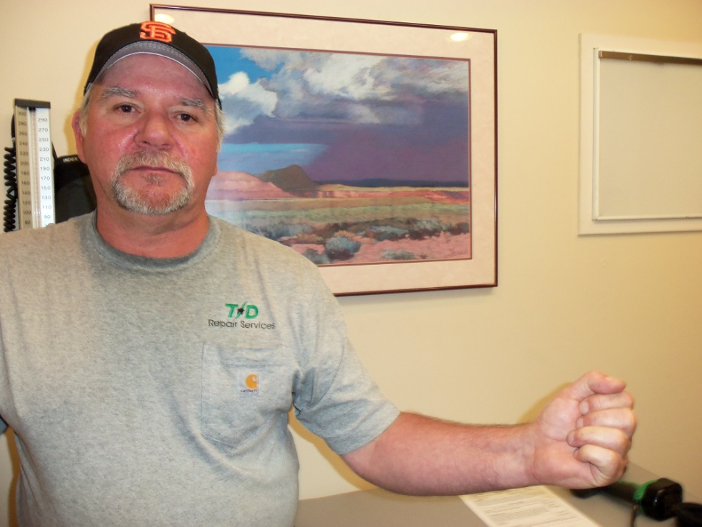

Slide 15
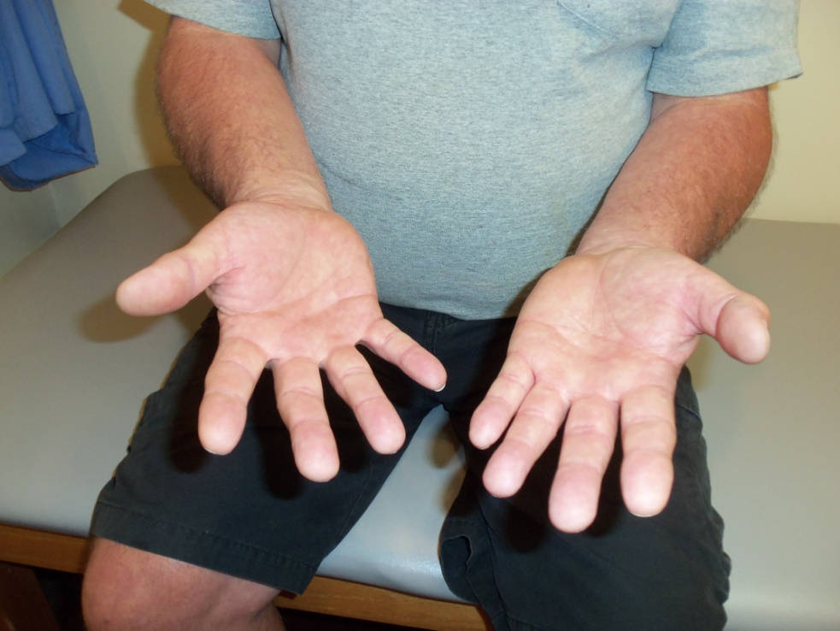

Slide 16
WCE results
Regular work release to Construction
Lift/ Carry 120 lbs
Push/ Pull 200 lbs
Work simulation:
Carrying 60+lb sandbags repetitive
Wheelbarrowing 200 lbs repetitive
Loading cinder blocks into back of his work truck
Validity testing

Slide 17
Results from testing
Settlement was offered prior to the WCE of $30,000.00
$10,000.00 was for Work Disability
Settlement was withdrawn and there will be no resulting Work Disability
MD concurred with the WCE results

Slide 18
Validity testing
Coefficient of variation testing
Waddell’s signs
Grip testing for sincerity of effort
Extensive history
Extensive physical examination
Fine motor- Purdue pegboard
Valpar Whole Body ROM
Videotaping of inconsistent behaviors

Slide 19
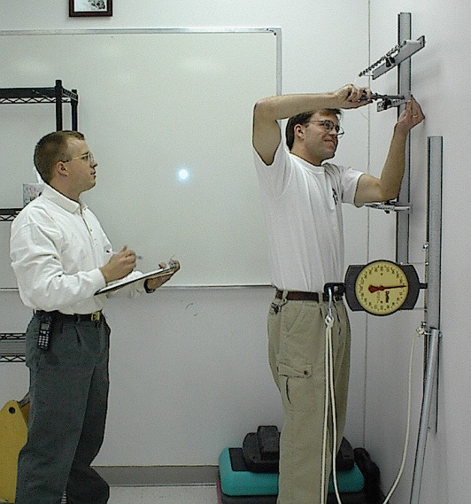
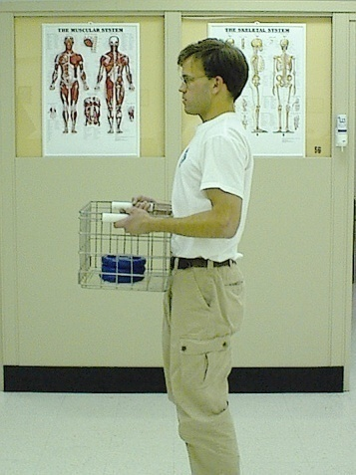
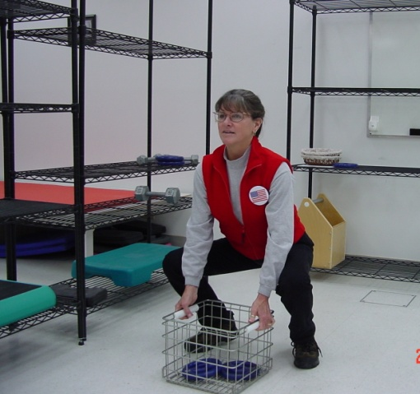
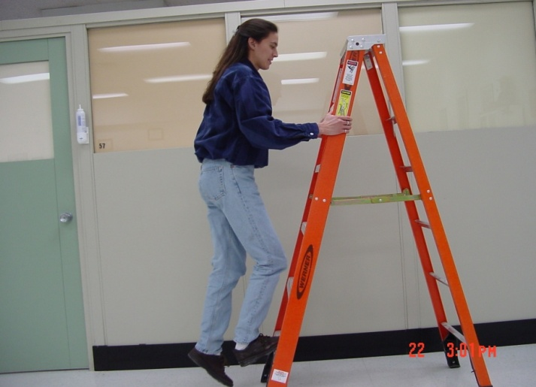
Functional Capacity Testing

Slide 20
Unrelated conditions
Physical functioning is always changing and can be influenced by other unrelated factors:
Prior injury to a body part
Degenerative diseases
Motivation
Drugs and drug seeking behavior
These should be identified to determine validity

Slide 21
Test focus
PCE / WCE testing is focused on the accepted conditions only
Limitations found to be due to unrelated conditions are indicated as such

Slide 22
Results
Results from the testing should be provided within one week of the test
Results are provided to the insurer only (the insurer will provide the test results to the provider for concurrence)
Please request the evaluator’s Bio, if you feel the provider may not concur

Slide 23
Questions to SAIF
During the WCE summary, do you want any recommended treatments to improve a condition for potential regular work
Do you just want to know from a WCE if this worker can now RTW regular or projected RTW capacities

